Slide 1




presents
TraffiKAI
A-EYE on ROADS
Team MLHeist
Akhil M G
Manikanta B
Shreyas K
Nishank K S
2022

Slide 2
CITIES WITH THE WORST TRAFFIC IN THE WORLD
NEW DELHI
Ranked 11th
MUMBAI
Ranked 5th
BANGALORE
Ranked 10th

Slide 3
DATA DOES NOT LIE!
Bengaluru’s congestion level was 48% in 2021.
According to the TomTom International Traffic Index, the last 7 days' congestion periods from 6 pm to 7 pm which is the rush hour was around 60 to 70 percent.
TomTom's website also posted that we “at Bengaluru” spend 244hrs extra time in the traffic.

Slide 4
DATA DOES NOT LIE!
According to Times of India about 146,133 people were killed in road accidents in India in the year 2016. Unfortunately about 30% of deaths are caused due to delayed ambulance.
According to the Radhee Disaster and Education Foundation, one in 10 patients in India dies on the way to hospital.
Another Indian government data shows that more than 50% of heart attack cases reach hospital late , which can constitute unavailability of ambulances too but majority of it is due to patients stuck in traffic.

Slide 5
PROBLEM STATEMENT
The increasing number of vehicles in cities can cause high volume of traffic, and implies that traffic congestion has become more critical nowadays. Keeping the same infrastructure and making delta changes in the system using the power of AI & ML.
Fatalities due to traffic delays of emergency vehicles such as ambulance & fire brigade is a huge problem. In daily life, we often see that emergency vehicles face difficulty in passing through traffic.

Slide 6
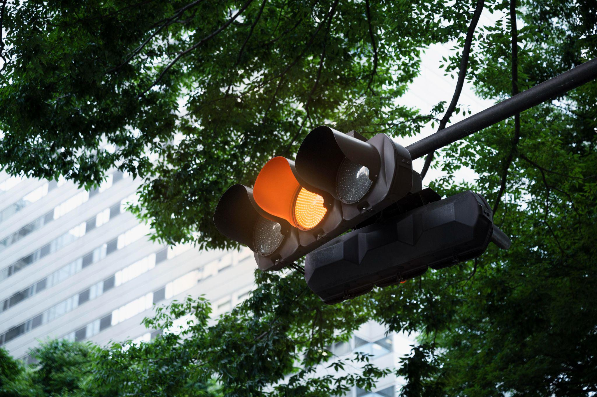
OBJECTIVE
Objective of proposed solution is to improve efficiency of existing traffic signaling system.
The goal of the project is to automate the traffic signal system and make it easy for the traffic police department to monitor the traffic.

Slide 7
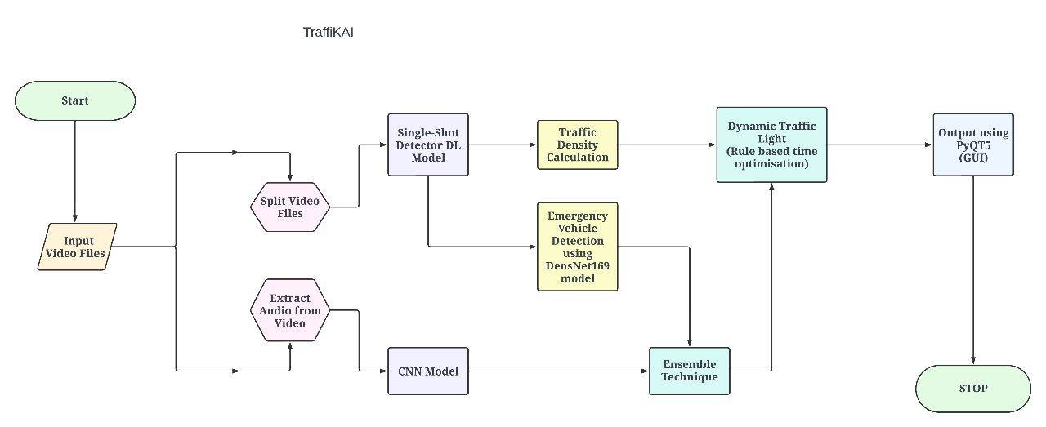
SYSTEM WORKFLOW

Slide 8
TECH STACK
Audio detection: Custom model using CNN Video detection: DenseNet-169 Object detection: SSD (Coco Dataset) GUI: PyQt5 Libraries: Tensorflow, OpenCV Streamlit

Slide 9
ASSUMPTIONS
Cameras should be installed at all the lanes in a given junction and should only capture lanes that have vehicles moving towards the junction.
The emergency vehicle should be in the range of sight of the camera.
COST
High resolution cameras to be installed for better video capturing.
Sufficient amount of processing power to run the model flawlessly.

Slide 10
FUTURE SCOPE
Collecting the data from junctions near hospitals allows better traffic management for easy emergency vehicle passing.
Implementation of an automatic traffic violation and helmet detection system without any human intervention completes the system.

